Slide 1
Classification of Mushrooms
Elif Çiçek Şensöz

Slide 2
Dataset
In 1981 data is gathered by The Audubon Society Field Guide to help shroomers for finding non-poisonous mushrooms. In 1987, data is donated by Jeff Schlimmer to UCI Machine Learning Repository.
8124 instance - 22 features
4208 edible
3916 poisonous
Missing Values: None

Slide 3

Features
22 Features
All of them are categorical
Label Encoding
Standard Scaler:

Slide 4
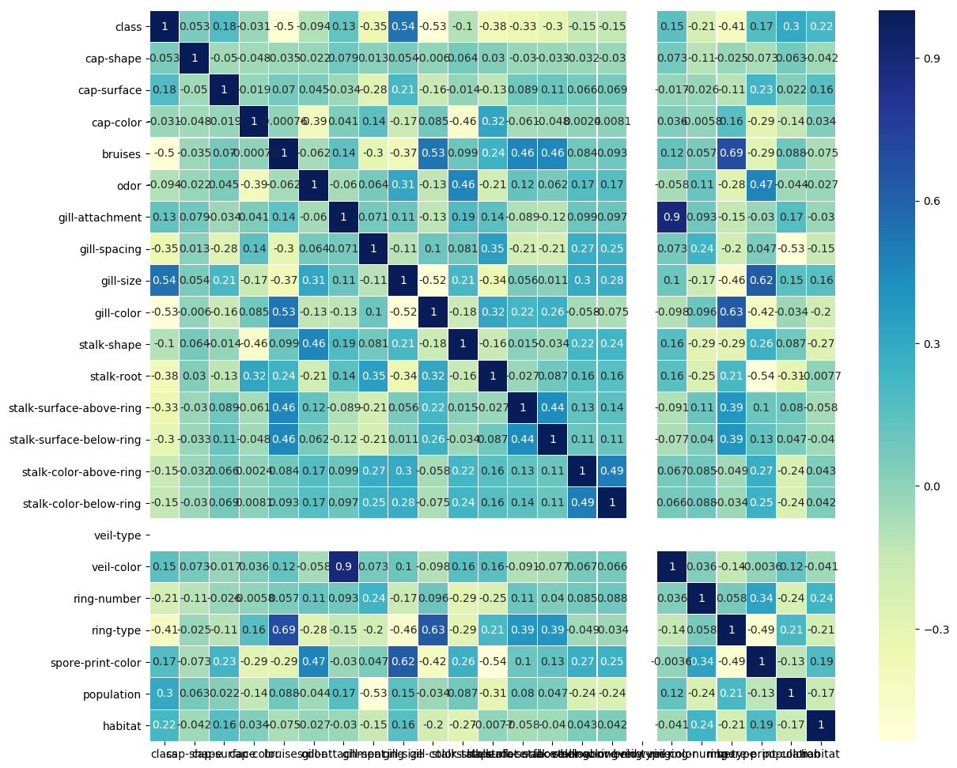

Slide 5
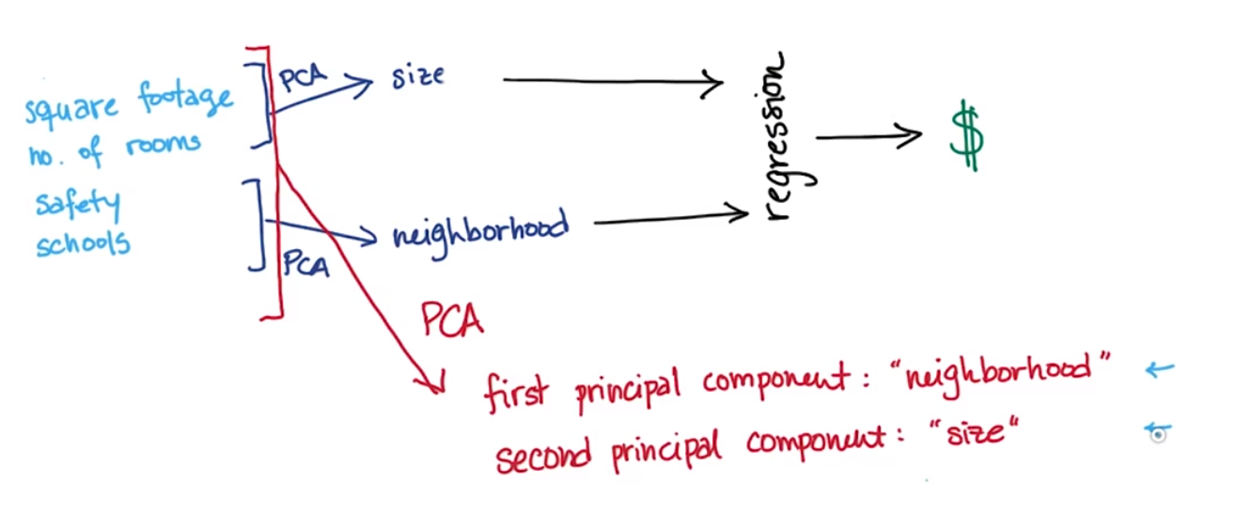
Principle Component Analysis

Slide 6
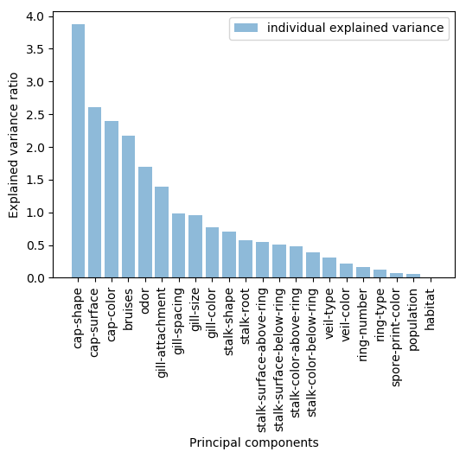

Slide 7
Cross Validation

Slide 8
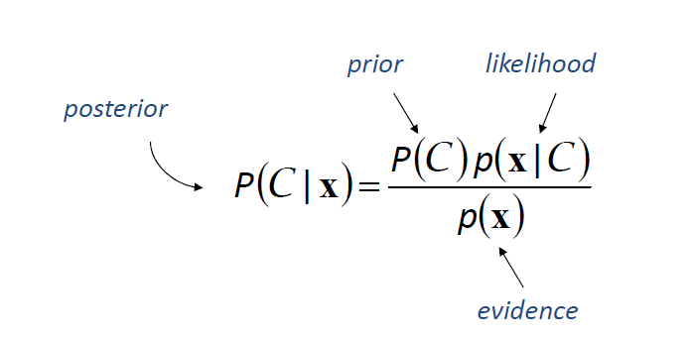
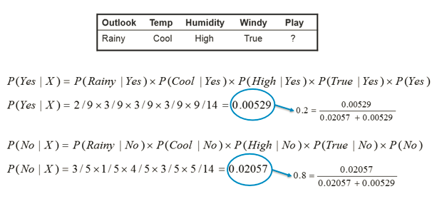
Naive Bayes

Slide 9
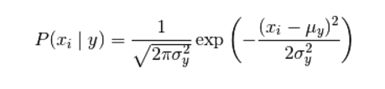
Gaussian Naive Bayes
It is used for Continuous Variables
Very simple, easy to implement and fast, needed less training data, scalable.

Slide 10
Decision Trees

Slide 11
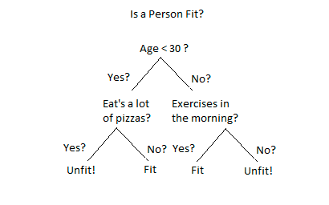
Decision Trees

Slide 12
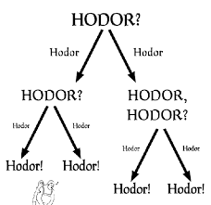
Decision Trees

Slide 13

Random Forest

Slide 14
Random Forest
Randomly selects observations/rows and specific features/variables to build multiple decision trees from and then averages the results
Classification and regression problems
It can be run in parallel to speed up training
Reduces variance by combining multiple decision trees.

Slide 15

Metrics
Accuracy:
ROC (Receiver Operating Characteristic) Curve

Slide 16
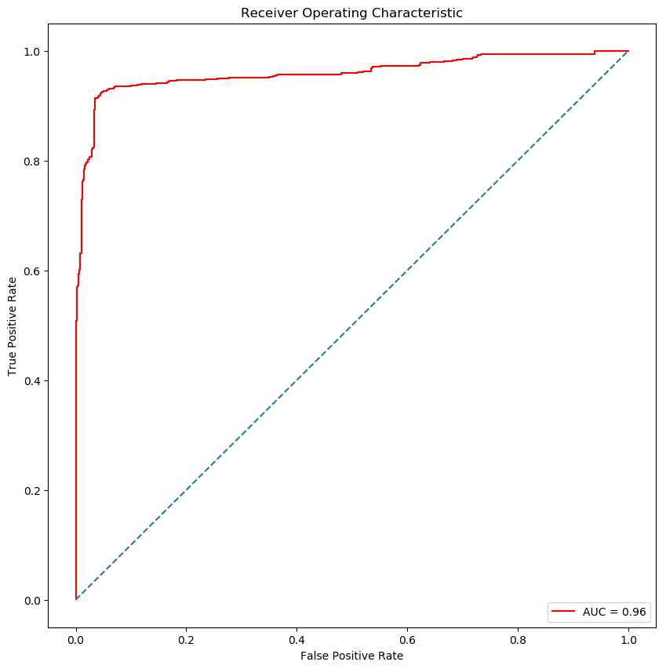
Results
Gaussian Naive Bayes

Slide 17
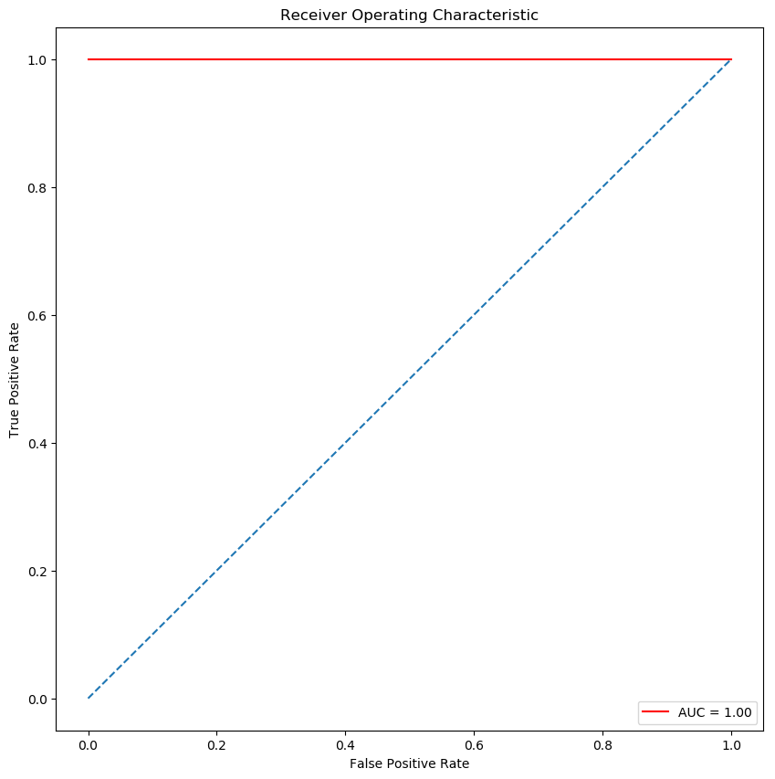
Results
Random Forest

Slide 18
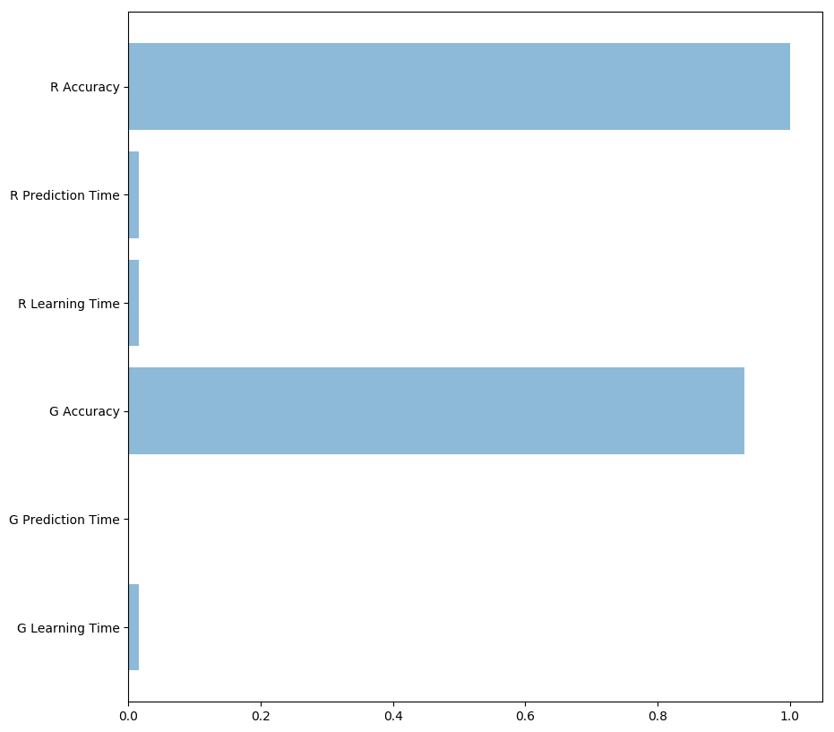
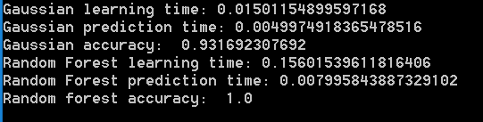
Conclusion

Slide 19
Further Research
Model Optimization

